Slide 1
Wenger vs 3rd Party Carriers

Slide 2
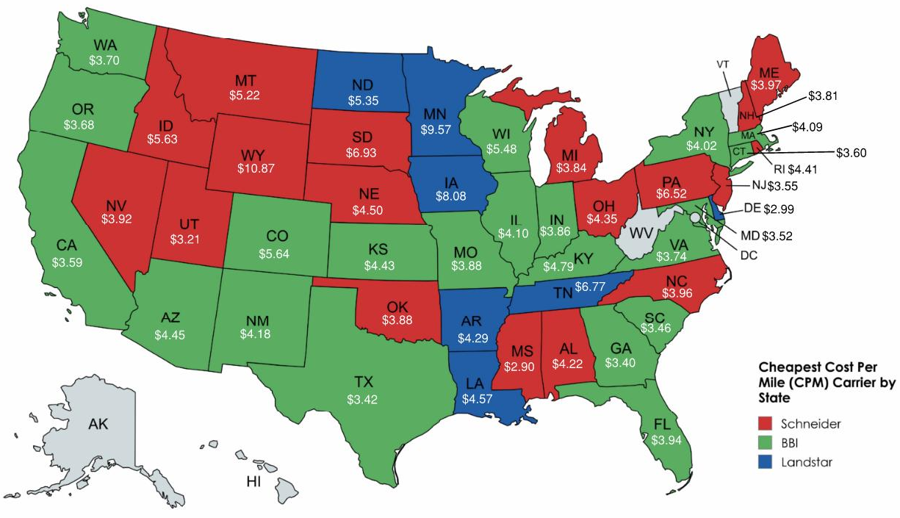
Approach for Analysis
Determined cost per mile (CPM) for each of the truckload carriers

Slide 3
Approach for Analysis
Assumptions Made
New incurred cost vs current 3rd party model

Slide 4
Approach for Analysis
Assumptions Made
Driver pay: $0.55 per mile
Employee benefits calculated at 30% of yearly estimated pay
Unemployment taxes calculated at 1.16% of employee’s salary
Work comp insurance is calculated at $8.00 per $100 of payroll (MN rate for Motor Freight Carrier Driver)
General commercial insurance was obtained through our insurance company using a ballpark figure provide by them
Vehicle tabs used 2023 cost
Fuel tax used 2023 cost
$4.02 Diesel price per gallon (2024 average)
Driver averages 110,000 miles per year
132 deliveries based off of 2023 data
52 mph overall average
All Wenger order data used was both delivery only and installations (pulled all orders that we used TL carriers on)

Slide 5
Cost Implications of Wenger vs. Third-Party
Wenger cost per mile (leasing equipment): $3.14 – all inclusive
Schneider cost per mile: $4.23
BBI cost per mile: $4.39
Landstar cost per mile: $4.99
Miles per year per driver: 110,000
Potential savings/year: $239,800/year (would reduce our cost & our customers price, but margin performance would stay the same)
Will require calculation of lower margin charged to customer
*Return pallet/dunnage removal cost elimination would all be additional savings not included
Average dunnage cost removal is $800 per order ($105,600 per year)
Average return pallet savings of $2,086 per delivery ($275,352 per year)
Multi-Stop Opportunities
Employing our own drivers is significantly more cost-effective than relying on third-party carriers

Slide 6
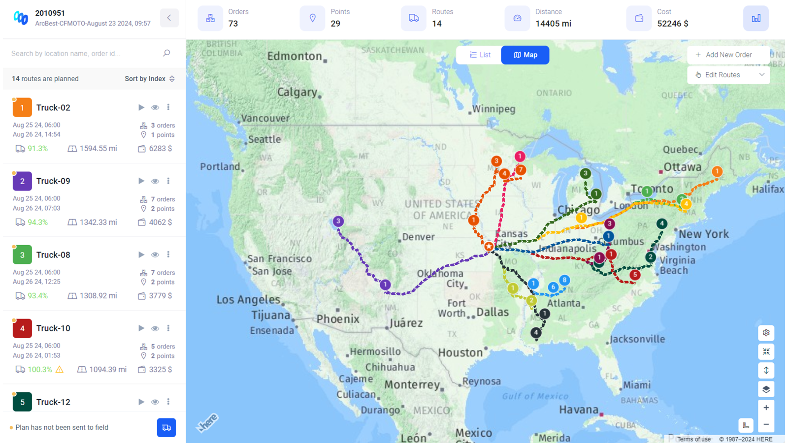
Use Case
Combination of multiple LTL shipments
Partner carrier currently using an optimization tool to combine multiple LTL shipments into one TL
17% cost savings compared to LTL pricing
One way (not including back haul potential)
Currently partnering with Arcbest to understand use of tool and potential implementation of backhaul
17

Slide 7
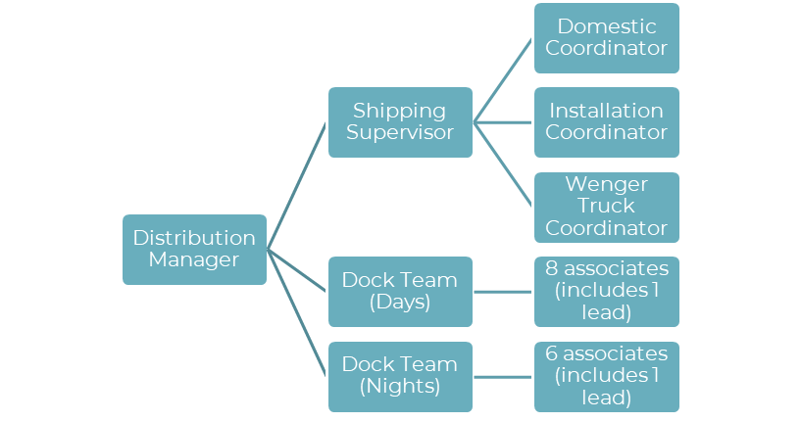
Shipping Supervisor Proposal
Currently, all distribution staff report directly to the distribution manager, this includes 17 associates (in various roles) across two shifts.
Current State
Proposed Future State (addition of Shipping Supervisor)
Distribution Manager
Domestic Coordinator
Installation Coordinator
Dock Team (Days)
6 associates (includes 1 lead)
International Coordinator
Dock Team (Nights)
8 associates (includes 1 lead)
3
17
15

Slide 8

Shipping Supervisor Proposal
Quicker response times, better team support, and an overall better customer experience.
Proposed Future State (addition of Shipping Supervisor)
Benefits
With the addition of 2 drivers, we will need a dedicated dispatcher to help coordinate outgoing shipments, backhauls, and return transactions on inventory. There is also opportunity for this role to support freight claims.
Would require role/responsibilities shifts
Supervisor role would lead to:
Additional support and less response time to logistics team and ultimately our customers (internal and external)
Additional support to dock team, improvement projects, and team development

Slide 9





Business Case
Wenger Corporation is committed to delighting our customers through continuous improvement
1
2
3
4
5
Cost and Price Reduction
Additional Team Support
Scalability with Business Growth Plan
Additional (Reliable) Service Offerings
Better Customer Experience
Ability to pass our savings down to our customer, while still achieving margin goals
More support to functional teams leads to reduced response times, increased morale, and ultimately better performance
Lays the foundation for scalability plan to align with company growth plans now and in the future
Meeting customer expectations for inside delivery and light install is tough to do with current carrier offerings
Better pricing, additional service offerings, and faster responses will enhance the customer experience both internally and externally

Slide 10
THANK YOU.

